Slide 1
Digital Storytelling and CCSS
iPad ideas for
Tiffany Abner Technology Integration Specialist Greenland School District

Slide 2
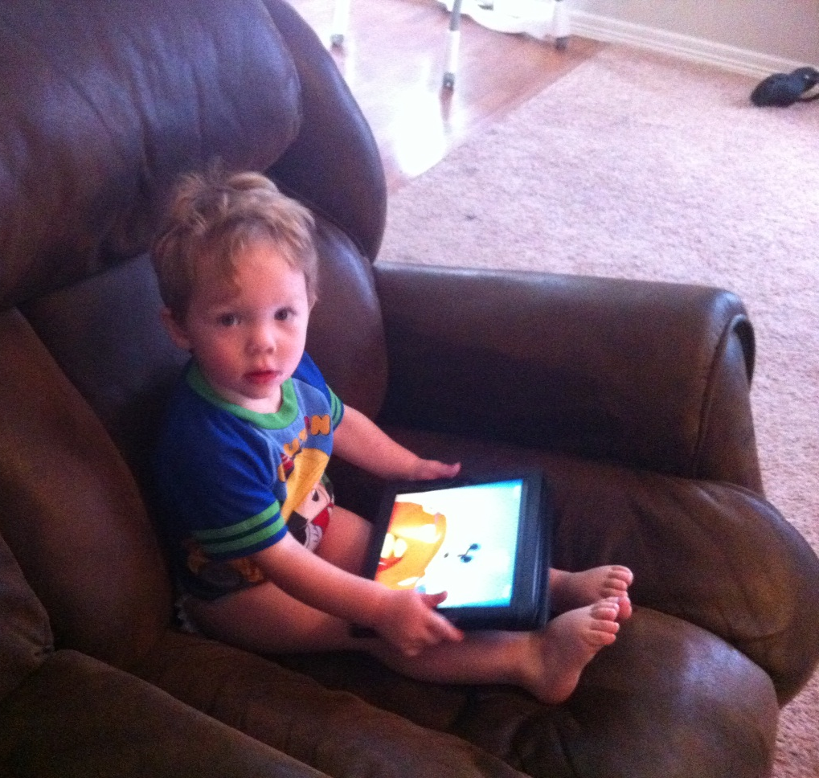
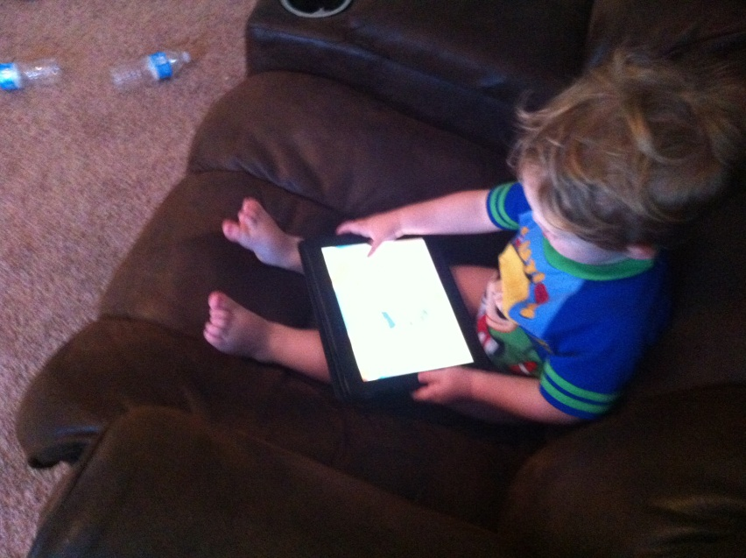
Easy Enough for Elijah

Slide 3
 | Writing.6 | Writing.8 | Speaking Lang.4 | Speaking Lang.5
K | “Explore a variety of digital tools to produce and publish” | “recall information from experiences or gather info from provided sources”
1st | All above plus “collaboration with peers” | Above plus “to answer a question”
 |  |  | Tell a story, speak audibly & coherent sentences | Create audio recordings of stories or poems….
2nd
3rd | All above plus “using Keyboarding skills” | Above plus “digital sources & take notes & sort evidence” | Above plus “Report on topic, understandable pace” | Above plus “add audio recordings & displays to presentations”
4th | All above plus “Type a min. of 1 page in a single setting” | Above plus “ provide a list of sources” | Above plus “relevant, descriptive details “ | Above plus “include multimedia components”
5th | Above plus “type a min of 2 pages in a single setting” | Above plus “summarize or paraphrase info. in notes” | Above plus “present an opinion, sequencing ideas” | Above plus “graphics, music, images, sound etc…”
6th | Above plus “type a min of 3 pages in a single setting” | Above plus “assess credibility of sources and avoid plagiarism” | above plus “present claims and findings” | Same as above
7th | Above plus “linking and citing sources” | Above plus “following a standard format of citation” | Same as above | Above plus “clarify claims and emphasize salient points
8th | Above plus “present relationships b/t info” | Same as above | Same as above | Above plus “add interest”
9th | Same as above “collaboration” | Above plus “use advanced searches, flow of ideas” | Above plus “support evidence clearly, concisely…” | Above plus “strategic use of digital media”
10th | Same as above | Same as above | Same as above | Same as above
11th | Above plus adding feedback | Above plus “multiple digital sources” | Same as above | Same as above
12th | Same as above | Same as above | Same as above | Same as above

Slide 4
Learning in Hand
handhelds can play a big part in project based learning
“Not only do projects motivate students because they use exciting handheld technology, but they also lend themselves to student voice and choice in their own learning” Tony Vincent
http://youtu.be/nbiBCx5rii4 (learning in hand part 1-10 min)
(What makes a good vice President)

Slide 5
Project Based Learning
Students work over an extended period of time answering a Driving Question (open ended)
The question is so deep that is requires students to create a project to share their findings with others
Can’t be answered with Copy and Paste
Incorporates many different subjects to deepen learning (cross curriculum) CCSS

Slide 6
Digital Story Telling
Transform your students' writing into a visual masterpiece that is filled with voice and emotion, while enhancing critical thinking skills.
Replace the traditional PowerPoint Project
The iPad takes digital storytelling to a new level
easier
engaging for students of all grade levels as well as teachers.

Slide 7
Great Project Examples
4th Grade Animal Assignment (8 minutes)
Created a mini documentary on an animal of their choice
www.vimeo.com/channels/animalproject

Slide 8
Project Ideas and Strategies
Teaching Channel.org
Pirate Technology Page (Greenland School District)
TeacherCast App (great podcasts!)
Google It!

Slide 9
Movie Making Apps
iMovie $4.99
Reel director $1.99
Splice
Video Star (music videos only)
Videolicious

Slide 10
Book Creating Apps
Strip Designer $2.99
Book Creator $3.99
Scribble Press (Great for lower grades)
Story Panda (Great for lower grades)

Slide 11
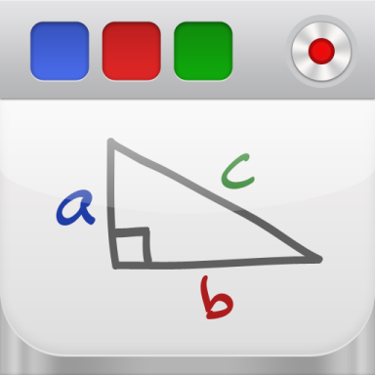
Recording WhiteBoard Apps
Educreations
ShowMe
ScreenChomp

Slide 12
Puppet Apps
PuppetPals Director’s Pass $2.99
Toontastic
SockPuppets
Little Pigs(Great for lower grades)
FairyTale(Great for lower grades)
Puppet(Great for lower grades)

Slide 13
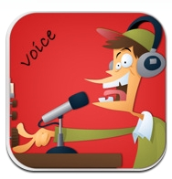
Creativity Apps
Home Design (2D and 3D)
Voice Morph
Comic Touch ($2.99 or free lite version)
Graph
Recorder Plus HD

Slide 14
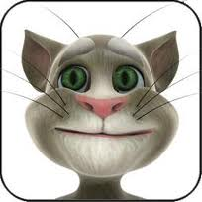
Talking Apps
Great way to add humor
Talking Tom
Talking Gina
Talking News

Slide 15
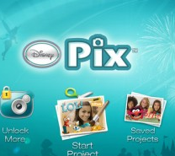
Photography Apps
Be Funky (online version too)
MegaPhoto (like photobooth but you can record! REALLY COOL)
DisneyPix
DoodleBuddy
Adobe photoshop express
PhotoPad
Animoto (limit 12 on FREE)
Frame Artist+
PicStich
Project 360
Revel
PicCollage
Pic Jointer

Slide 16
Productivity Apps
Notes
Evernote
Google Search
Documents
Spreadsheets
Must have a gmail account
Dragon Dictation
CloudOn
Rover
Photon Flash Web Browser

Slide 17
Tutorial/Storage Apps
iTunesU
TeacherCast
Khan Academy
Enchanted Dictionary
Army Careers
TED
DropBox
QR Reader

Slide 18
Presentation Apps
Prezi
SlideShark
VoiceThread

Slide 19
Grading Projects
http://rubistar.4teachers.org/
Great website for creating/searching rubrics
FREE to sign up
Download to excel format
Teacher Tips
Create your rubric with the students
Give a copy of rubric to your students BEFORE you assign the project
Have students grade each other’s project before they turn it into you (make it part of their grade)

Slide 20
Tiffany Abner Technology Integration Specialist Greenland School District e-mail: tabner@greenlandsd.com @ tiffyabner Look for me on LinkedIN

