Slide 1
Apple App Volume Purchasing Training
Tiffany Abner
Greenland School District

Slide 2
Objectives
Request an app to be purchased
Redeem an app on your Apple device
If we have time:
Upgrade your device to iOS5

Slide 3
Requesting an App
Must fill out a form
Available on the Greenland website below the Technology Request Form
App Request Form
(Make sure YOUR Greenland Account is listed at the top)

Slide 4
Request Form
Full Name of App
Quantity Needed
Which Apple device(s) will it be loaded
Brief description
How do you plan to use it?
How often are you going to use it?
Can other people in the district benefit from it too?
This question is important because if we purchase more than 20 a discount is applied to most educational apps

Slide 5
Request Approval Process
There is money available in the budget
Approval of app will be based upon the answers on the request form
Rick will make the ultimate decision

Slide 6
Redemption of App
When approved
Rick or I will purchase the app using the volume purchasing account
Rick or I will send you a code or a link to REDEEM the app
Once the app is REDEEMED it can be synced to the other devices that you want the app to appear

Slide 7
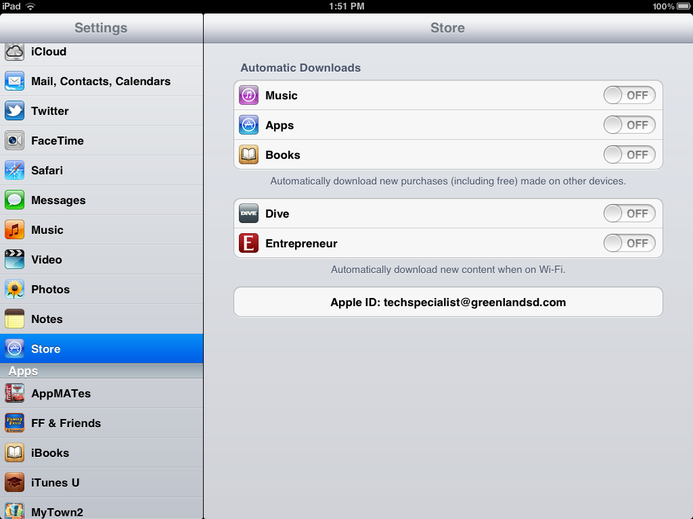
Redemption Process
Rick or I will send you a redemption code or link to your greenlandsd email address
Your own greenlandsd.com email
Your itunes greenlandsd.com email
To enter the code:
Make sure you are logged into your greenlandsd.com itunes account
Go to settings
Store
Apple ID should be your greenlandsd.com itunes account

Slide 8
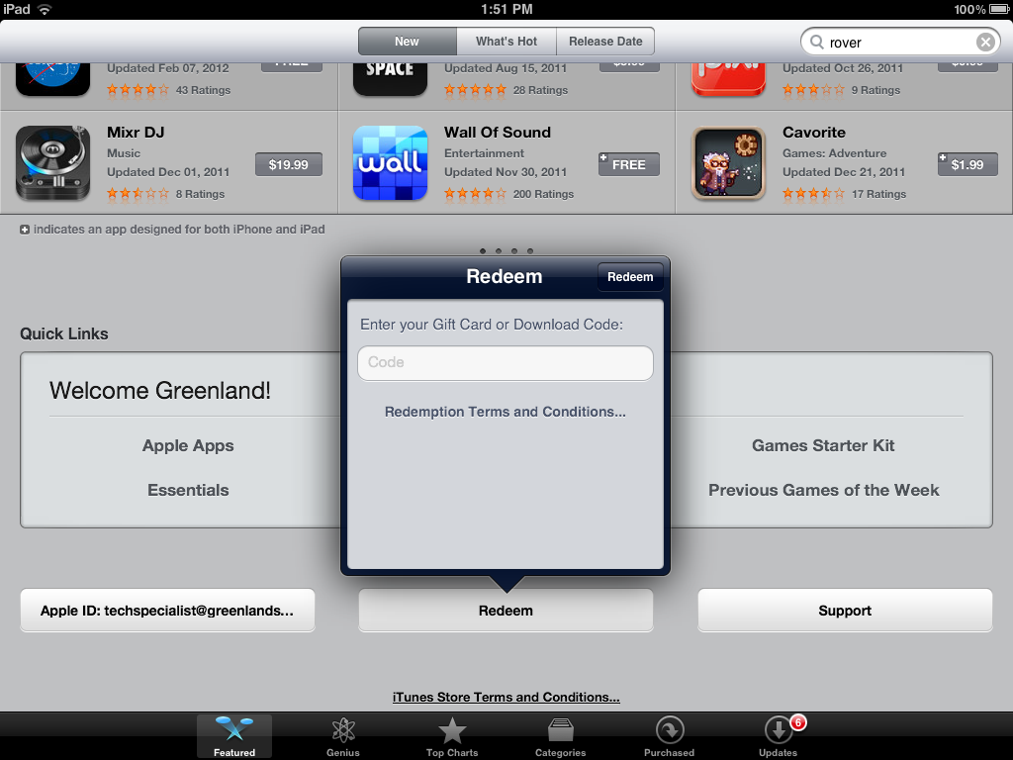
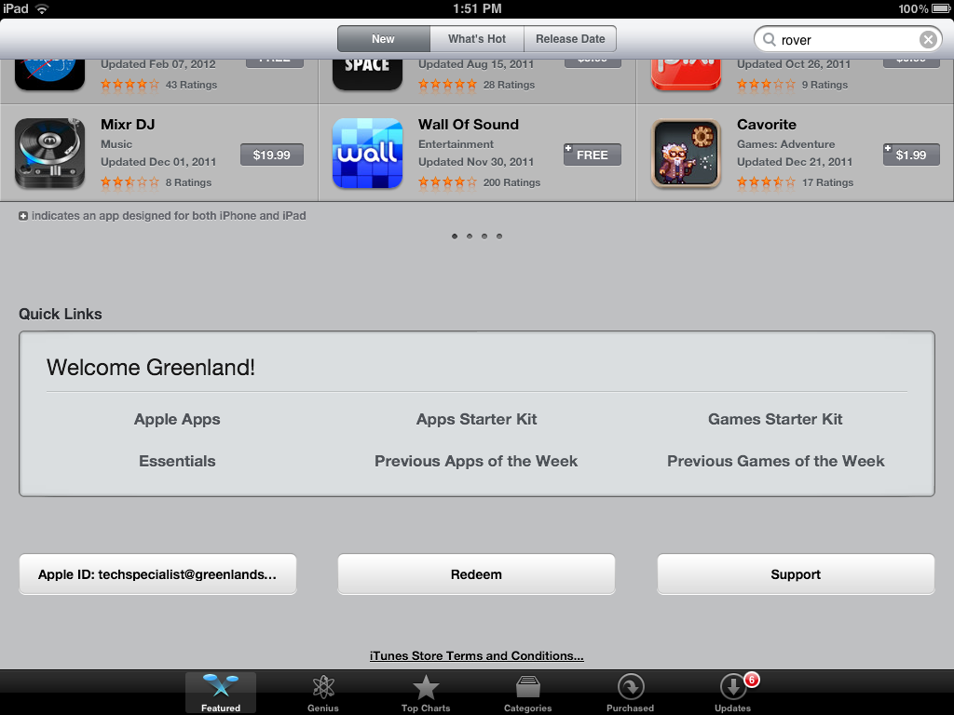
Redemption Process Cont.
Go to the app store
Scroll down at the bottom until you see the REDEEM button
Enter the code and your greenlandsd.com itunes password

Slide 9
Redemption Process Cont.
To use the link
This has to be e-mailed to your itunes account greenlandsd.com email
You just click on the link

Slide 10
Syncing to all devices
If we purchased enough licenses for all your devices then you can sync the app to the other devices without putting in a code for each device
If we only purchased 1 license for an app then you have to make sure that your automatic downloads option for apps is turned off on your device
Go to Settings
Choose Store

Slide 11
Upgrading to iOS5
Using your USB cable, hook up to the computer that has your itunes account
Locate the device on the left side of the screen and click on it
Under the Summary Tab click “update”
This will take quite a bit of time depending on how many apps you have on your device
http://www.apple.com/ios/features.html

Slide 12
QR Code

